Slide 1

Chapter 13:
Introduction to Classes
By Tony Gaddis
Slides modified and supplemented by Clare Nguyen

Slide 2
13.1
Object Oriented Programming

Slide 3
Procedural vs. Object Oriented Programming
Procedural programming focuses on how procedures or functions run in a program. Procedures act on the data in the program.
Up to this point, our program design is about how functions interact with each other to manipulate the data in the program.
Object oriented programming (OOP) focuses on the data or the objects. Each object is considered a data entity and has member functions to support it.
Now our program design is about how objects behave and interact with each other.

Slide 4
Getting started in OOP
Data objects of the same type are created or instantiated from a blueprint called a class.
A class is an ADT or an abstract data type. A class typically have multiple data fields, similar to a struct, but a class also has member functions that are written specifically for it.
For example, the string class can store a text string and has functions that work with the text string.
Once a class is declared, the class name becomes a user-defined data type, which means an object can be created with the data type of the class.
For example, many string objects can be created from the string class.

Slide 5
OOP Terminology
When an object is created from a class, the object is instantiated from the class
The attributes of a class are the data of the class, which are also called member data
The methods or behaviors of a class are the functions of a class, and they are also called member functions
When an object is instantiated, it contains all the member data and member functions of its class.
One main philosophy of OOP is the concept of encapsulation: member data and member functions that operate on the data are bundled together into one class
Another philosophy of OOP is the concept of data hiding: member data are not accessible to functions that are outside of the class or non-member functions
Since member data of a class are hidden, classes have a public interface, which are member functions that can be called by non-member functions.
In OOP an object provides limited access to its data and functions without sharing its internal details and design

Slide 6
13.2, 13.4
Introduction to Classes

Slide 7
Introduction to Classes (1 of 2)
A class is an ADT: it is a data type that is created by the programmer to represent a group of data or an abstraction of data
Similar to a struct, a class must be declared so the compiler knows what is it is composed of, before objects of the class can be created in memory
Unlike a struct, a class declaration has both data fields and function prototypes
class declaration: class ClassName
{
private:
data declarations;
function declarations
public:
function declarations;
};
The access specifiers for the data and functions of a class can be private or public

Slide 8
Introduction to Classes (2 of 2)
Access specifiers control the kind of access to the member data and functions:
public: can be called or accessed by functions outside of the class
private: can only be called or accessed by functions that are members of the class
Access specifiers can be listed in any order in a class and can appear multiple times within a class
If an access specifier is not listed, the default access is private

Slide 9
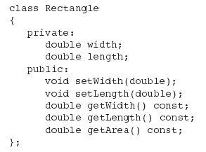
Example of a Class Declaration
Private Members
Public Members

Slide 10
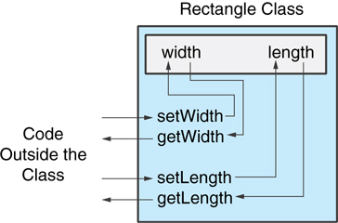
Why Have Private Members?
Making data members private provides data protection
Data can be accessed only through public functions, and the public functions limit how data can be changed so there’s less chance that data will be corrupted
Public functions make up the class’s public interface, and code outside of the class must use the class's public member functions to interact with the object
A member function can also be private, which means it can only be called by another member function. A private function is used for internal data processing by the object.

Slide 11
Member Functions
Member function prototypes
Member function declarations or prototypes appear inside the class declaration
If the prototype is listed after the public access specifier, then the function is a public function
If the prototype is listed after the private specifier, then the function is a private function.
Member function definitions
Member function definitions typically appear outside the class declaration
Because the definition is outside the class declaration, we must use the class name and scope resolution operator (::) in the function header:
void Rectangle::setWidth(double w)
{
width = w;
}

Slide 12
Types of Member Functions (1 of 2)
A mutator is a member function that changes the value of a private member variable
setWidth is a mutator because it changes the width member data
An accessor is a member function that returns the value of a member variable
getLength is an accessor because it returns the length member data and does not change it
Since accessors do not change an object's data, they are marked with const in the function prototype and function header to show that they will not change any member data
The keyword const appears after the parentheses in both the function prototype and function header:
double getLength() const;
getLength will not change data of the Rectangle object,
getLength is called a const function

Slide 13
Types of Member Functions (2 of 2)
When an accessor returns a member data which is a pointer variable, it is possible for the caller of the accessor function to use the pointer (the address) to change the member data. This violates the data hiding concept of OOP.
Therefore, when an accessor returns a pointer variable, it should return a const pointer
Example:
char * getfFilename() const {
return filename; }
Anyone can use the return pointer (char *) to change the filename member data
const char * getfFilename() const {
return filename; }
Now it’s not possible to change the filename and the data is safe

Slide 14
Member Data
Member data should be private so that functions from outside of the object cannot access them
This means that a member data may need an accessor so that the data can be seen from outside the object
double getLength() const; // shows the length to others
This also means that a member data may need a mutator so data from the outside can be stored in the object
void setWidth(double w); // stores w value in the object
Don’t create member data that is used to store the result of a calculation of other member data
Example: a member data called area in the Rectangle class could be used to store the area of the Rectangle object
However, area depends on length and width, and if we change length or width without updating area, then area would become stale
To avoid stale data, it is best to calculate the value of that data within a member function rather than store it in a variable
In the Rectangle example, the area is calculated by the getArea function

Slide 15
13.3
Defining an Instance of a Class

Slide 16
Defining an Instance of a Class
An object is an instance of a class
An object is defined with the class name as the data type:
Rectangle r;
When an object is created from a class, it is said that the object is instantiated from the class, or the object is an instantiation of the class
Once the object is defined, to call public member functions, use the object name with the . (dot) operator:
r.setWidth(5.2);
cout << r.getWidth();
The . operator is used in the same way as with a struct
Attempt to access private member will result in a compiler error

Slide 17
Dynamically Allocating an Object
An object takes space in memory, therefore it has an address, and that address can be stored in a pointer variable
Rectangle * rPtr;
From a pointer, access public members with the -> operator (just like with a struct):
rPtr = &otherRectangle;
rPtr->setLength(12.5);
cout << rPtr->getLength() << endl;
We can also use a pointer to access a dynamically allocated object
rPtr = new Rectangle;
rPtr->setLength(2.5);
rPtr->setWidth(1.3);
cout << rPtr->getLength() << endl;
delete rPtr;
rPtr = 0;

Slide 18
13.5
Separating Specification from Implementation

Slide 19
Separating Specification from Implementation
Due to the philosophy of data hiding and then providing a public interface to the object, a C++ class is coded in 2 separate files
The class specification file or class header file is named ClassName.h
It contains:
the class declaration
the public member function prototypes
Example: Rectangle.h
The .h file is the public interface for the class
The class implementation file is named ClassName.cpp
It contains member function definitions
Example: Rectangle.cpp
The .cpp file is the private file that hides the implementation of the class
The .cpp file should #include the .h file
Programs that use objects of the class must #include the .h file, and be compiled and linked with the .cpp file

Slide 20
Working with Header and Implementation Files
To work with a user defined class, your program will consists of multiple files
If your source file is called mySource.cpp, and it works with the class Rectangle, then there are 3 files that make up your program:
mySource.cpp, Rectangle.cpp, and Rectangle.h
mySource.cpp will need to add #include “Rectangle.h”
Rectangle.cpp always needs to #include “Rectangle.h”
Note that Rectangle.h is inside “ ” and not < > like with library header files
In your IDE’s project, you need to add into the Source folder:
mySource.cpp and Rectangle.cpp
You don’t need to add Rectangle.h if it’s in the same directory as Rectangle.cpp
As you code each of the source file, you can select to Compile (not Build) each of the .cpp file to make sure there is no syntax error
Don’t compile the .h file. There is no code for it to compile.
When each of the .cpp files compiles without error, then you can select Build Project to link all the object files into an executable

Slide 21
13.6
Inline Member Functions

Slide 22
Inline Member Functions
If a function has a short block of code for the function body, it can be turned into an inline function
An inline function definition appears in the class declaration
Example: Rectangle has 3 const inline functions
class Rectangle
{ private: double width; double length;
public: void setWidth(double); void setLength(double); double getWidth() const {return width;} double getLength() const {return length;} double getArea() const
{return width * length;}
};

Slide 23
Inline vs. Regular Member Functions
Regular functions: when the function is called, there is some set up time as execution jumps to the code of the function and then returns to the caller
Inline functions: the code of the function is substituted into the program in place of the function call, resulting in a larger executable program. However, execution does not need to jump to another place in the program so execution is faster
In general, due to the code substitution, inline functions should be short (1 to 3 lines of code)

Slide 24
13.7
Constructors

Slide 25
Constructors
A constructor is a member function that is automatically called when an object is created
Rectangle rect; // a constructor runs to create rect
The constructor function name is the class name, and it has no return type (not even void)
Rectangle();
A constructor usually has code to initialize member data
Rectangle::Rectangle()
{
length = width = 0.0;
}
A default constructor is a constructor that takes no arguments. The constructor shown above is a default constructor
If you write a class with no constructor at all, C++ will write a default constructor for you: this constructor will create an object in memory, but does nothing else with this object
If the Rectangle class has no constructor, then a Rectangle object will be created but its member data will be uninitialized
A simple instantiation of a class (with no arguments) calls the default constructor

Slide 26
13.8
Passing Arguments to Constructors

Slide 27
Passing Arguments to Constructors
A constructor can accept input arguments just like any other functions
// function prototype Rectangle(double w, double len);
// function definition Rectangle::Rectangle(double w, double len) { width = w; length = len; }
// function call
Rectangle r(10, 5);
If all of a constructor's parameters have default arguments, then it is a default constructor Example:
Rectangle(double = 0, double = 0); // prototype

Slide 28
13.9
Destructors

Slide 29
Destructors
A destructor is a member function that is automatically called when an object goes out of scope (for a local object) or is released from memory (for a dynamically allocated object)
The destructor name is ~classname, for example, ~Rectangle
It has no return type and no input arguments
There can only be one destructor per class
A class may not need a destructor if all its member data are local variables and not dynamically allocated
If a constructor dynamically allocates memory for any member data, the destructor is needed so it can release this memory

Slide 30
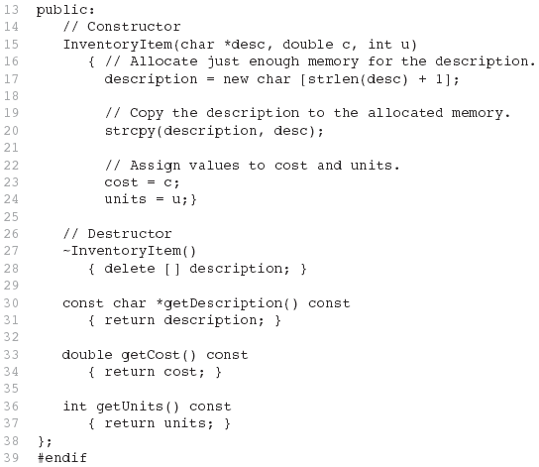
Example of a Destructor
constructor dynamically
allocates memory
destructor needs to
release memory

Slide 31
13.10
Overloading Member Functions

Slide 32
Overloading Member Functions
A class can have more than one constructor
Overloaded constructors in a class must have different parameter lists: Rectangle(); Rectangle(double);
Rectangle(double, double);
Do not provide more than one default constructor for a class: a constructor that takes no arguments and a constructor that has all default arguments are both default constructors
When all of a class' constructors require arguments, then the class has no default constructor
Non-constructor member functions can also be overloaded:
void setCost(double);
void setCost(char *);
Each overloaded member function must have a unique parameter list

Slide 33
13.12
Arrays of Objects

Slide 34

Arrays of Objects (1 of 2)
Objects can be the elements of an array:
InventoryItem inventory[4];
A default constructor is used when the array is defined but not initialized
To define and initialize an array of objects, we must use an initializer list to invoke a constructor that takes arguments:
InventoryItem inventory[3] = {"Hammer","Wrench","Pliers"};
If the constructor requires more than one argument, the initializer list must take the form of a function call:

Slide 35

Arrays of Objects (2 of 2)
It is possible to call different constructors for each object in an array when initializing the array:
Object elements in an array are referenced using subscripts
Member functions are referenced using . (dot) operator
inventory[2].setUnits(30);
cout << inventory[2].getUnits();

Slide 36
13.15
The Unified Modeling Language

Slide 37
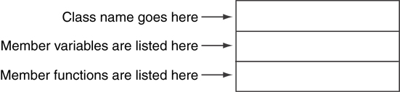
The Unified Modeling Language
UML is for Unified Modeling Language
The UML provides a set of standard diagrams for graphically depicting object-oriented systems
A UML diagram for a class has three main sections
A private member starts with a minus (-) and a public member starts with a plus(+). Example: +setWidth()
The data type of a member variable follows the name of the variable, with a colon in between. Example: width : double
The data type of a function’s parameter follows the name of the parameter, with a colon in between. Example: +setWidth(w: double)
The data type of a function’s return value follows the function’s parameter list, with a colon in between.

Slide 38
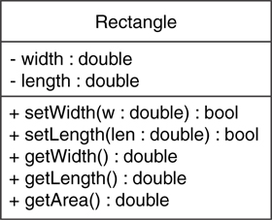
UML Example: Rectangle Class
class Rectangle
{
private:
double width;
double length;
public:
bool setWidth(double);
bool setLength(double);
double getWidth() const;
double getLength() const;
double getArea() const;
};

Slide 39
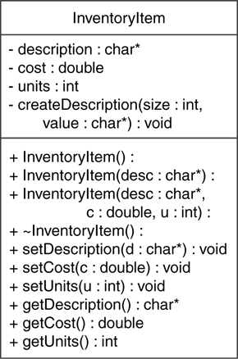
UML Example: InventoryItem Class
No return type listed for constructors or destructors but : is still needed

